Slide 1
Student Metric Project
By: Sheridan Burns and Michael McGinn

Slide 2
TABLE OF CONTENTS
01
02
Problem Background
Data Collection and Preprocessing
03
Data Analysis and Findings

Slide 3
01
Problem Background

Slide 4

Defining the Client
Key Clients
Dr. Farmer
The ISA Department
Key Stakeholders
Data Stewards and Scientists
Database Users
Other Faculty and Departments

Slide 5
Client Jobs and Pains
Add clarity and organization to the data
Hard to Understand
Define a functional student classification
Determine true graduation numbers
Unorganized
Hard to Track

Slide 6
Research Questions & Goals
What student success metric can be tracked or analyzed to provide a functional definition of a student’s academic standing?
What student success metrics can be used to establish a procedure to accurately count student graduates each semester?
How can the data table elements be cleaned and combined to add clarity to the content of the student success data and allow for our analyses to be easily reproduced?

Slide 7





Deliverables and Methodologies
Inputs
Outputs
Solution

Slide 8
02
Data Collection and Preprocessing

Slide 9
Data Overview
Student Attributes
Student Degrees Awarded
Student Grades
Student Majors
Students
Academic Standing
Gender, First Generation, Semester GPA
Finished Degrees, Finished Term Code
Courses, Grades, GPA
Majors, Term Codes, Cohort Terms, Classification
Student ID, Enroll Count
Term Count, Determination, Term Code

Slide 10
Data Origination and Integrity Analysis
Where is the data from?
How is the data sorted and tracked?
Data Pros
Thorough Detail
Manageable Size
Tabular Format
Opportunity for Improvement
Data Cons
Unspecified Sampling Procedure
Only a Sample
Limited Scope
Missing Values
Unknown Organization

Slide 11
Preprocessing
2. Removing irrelevant rows from Students tables
1. Altering the structure of Majors, Grades, and Degrees Awarded
4. Imputed blanks in Majors with ‘None’
3. Removed columns from Majors: Enrolled Student Count and Empty Majors

Slide 12
03
Data Analysis and Findings

Slide 13
Goal One: Functional Academic Standing
Process Steps
Create Term Order column in Majors tables
Add Academic Standing column in Majors tables
Freshman: 1-2 term codes
Sophomore: 3-4 term codes
Junior: 5-6 term codes
Senior: 7+ term codes
Filter Majors tables for Major and Co-Major Students
Process Opportunities
Progress able to be tracked over time in Majors tables
Not influenced by outside factors like incoming credit hours
Easy, consistent method to reproduce
Provides a strong base for graduate determination

Slide 14
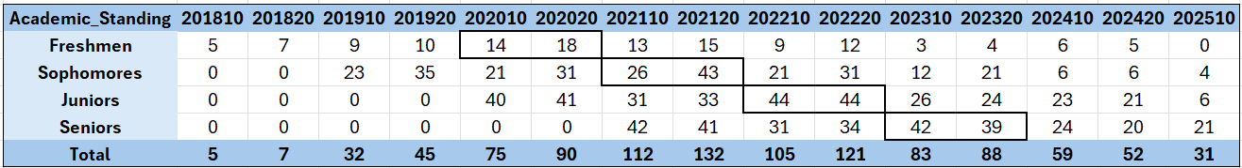
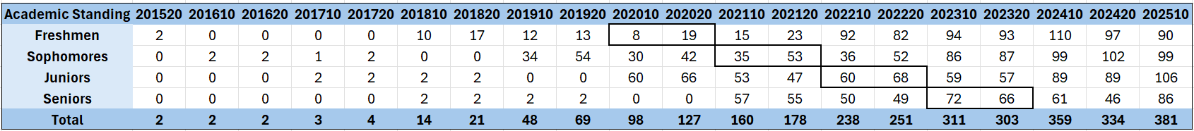
Goal One: Functional Academic Standing Table
IS Academic Standing
BA Academic Standing

Slide 15
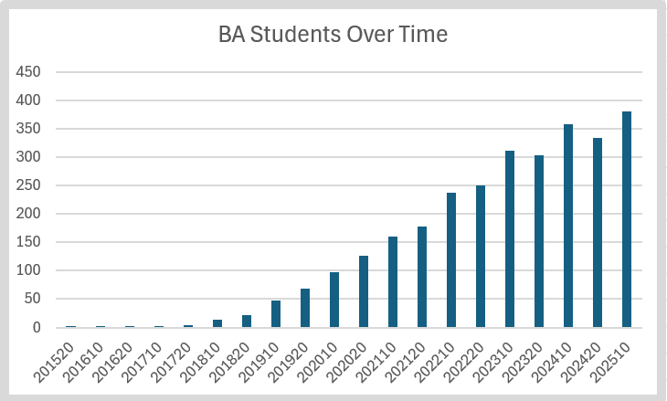
Goal One: Functional Academic Standing Table

Slide 16
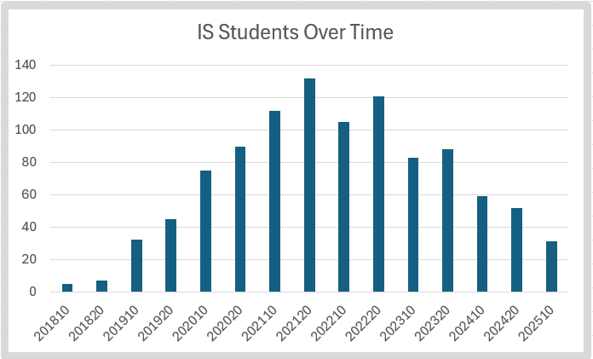
Goal One: Functional Academic Standing Table

Slide 17

Goal One: Functional Academic Standing Understanding
General Trends
Taking extra semesters to graduate
Leaving school during the 202020 and 202110 terms
Transferring in
Transferring out
BA Academic Standing

Slide 18
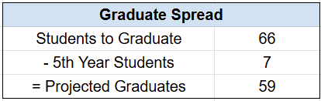


Goal Two: Graduate Determination
Overall Findings
59 expected BA graduates following the 202320 semester
7 students tracked as later graduates
66 total seniors as shown in previous slide
65 of the students actually graduated
Notes:
Based on our research, we hypothesize that Dr. Farmer’s Spring Seniors numbers are inflated due to factoring a student’s accumulated hours into their classification. For example, take myself. I came in with many credit hours and was considered a senior my sophomore year. Thus, I would potentially be included in the senior count. Then, when comparing the actual number of graduates Dr. Farmer’s will be a bit higher because the degrees awarded table includes many students under the BA degrees umbrella, such as there were a few data analytics students in that table that our particular analysis did not focus on since the basis of our analysis was the BA majors table that only shows students with BA Majors of comajors.

Slide 19
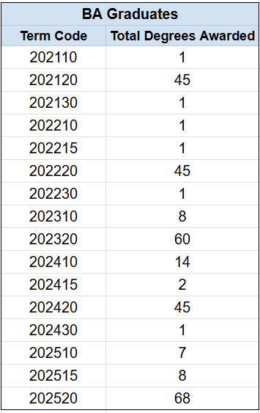
Findings Two: Degrees Awarded
Identifies total graduates, breaks them down by term code and degree type awarded
We believe that vast majority of predicted student graduates did graduate
More data needed to support conclusion
Granularity of Degrees Awarded poses a challenge

Slide 20
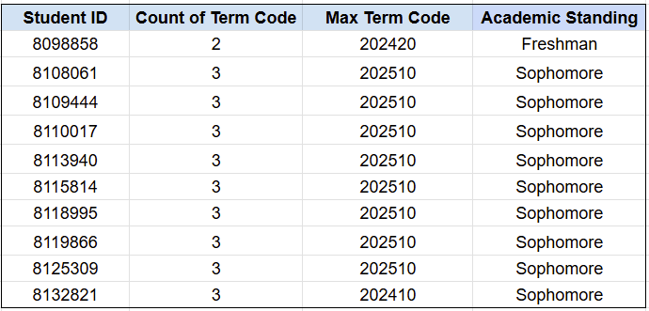
Goal Three: Coherent Merging and Cleaning
New Academic Standing Table
Overview of Current Student Status
Absorbs Student table
Columns:
Student ID
Max Term Code
Count of Term Code
Academic Standing based off of term code count

Slide 21
Findings Discussion
Academic Standing: Students classified based on completed semesters provided a reproducible method, but student progression varied due to individual academic journeys.
Student Migration: There is significant movement in and out of the ISA department. This can create ambiguity when tracking student progress.
Validation: Graduation tracking methods aligned closely with actual outcomes, suggesting the validity of our approach.

Slide 22
Findings Limitations
Education is Inherently Unpredictable
Hard to Understand
Unknown Sampling Conditions and Parameters
Each Student Has a Unique Story
Unorganized
Hard to Track

Slide 23
Conclusion
Challenges
Data Collection Uncertainty
Data Integrity Issues
Better Data Communication
Unique Student Journeys
Data Difficulty
Improvements
Understanding of Data Breakdown
More Efficient Organization
Knowledge of Integrity Issues
Functional Classification
Knowledge of Anomalies

